Slide 1
Stock Prediction using LSTM and Technical Indicators (RSI & SMA)

Slide 2
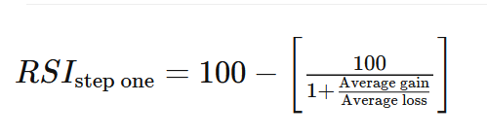
Relative Strength Index (RSI)
Momentum indicator used in technical analysis that measures the magnitude of recent price changes to evaluate overbought or oversold conditions in the price of a stock .
The RSI is displayed as an oscillator and can have a reading from 0 to 100.

Slide 3
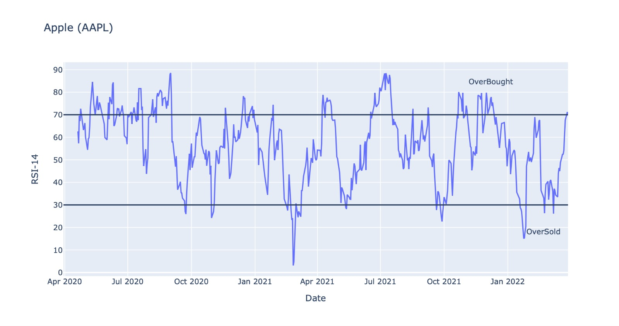

Slide 4

Simple Moving Average (SMA)
Core indicators in technical analysis, and there are a variety of different versions. SMA , EMA , EWMA,
SMA is simply the average price over the specified period.

Slide 5
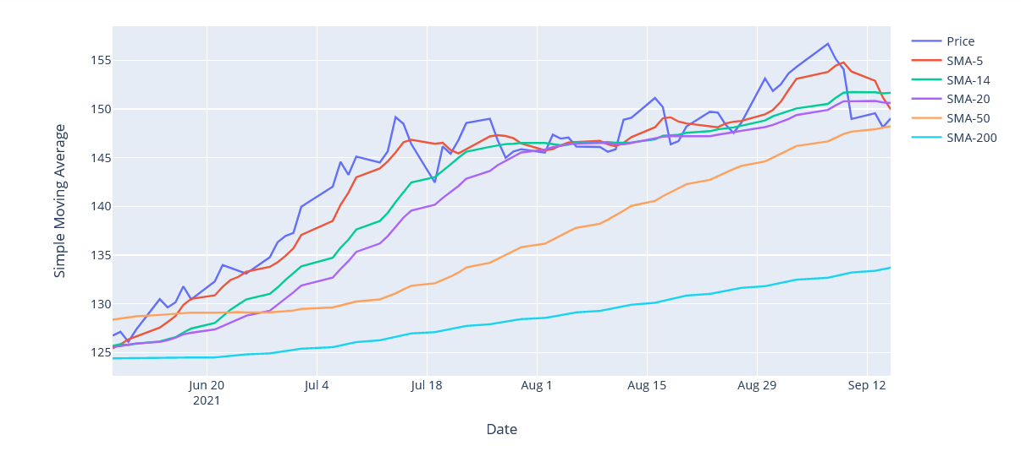

Slide 6

Long Short-Term Memory (LSTM) networks
Special kind of RNN, capable of learning long-term dependencies.
A common LSTM unit is composed of a cell, an input gate, an output gate and a forget gate.
The cell remembers values over arbitrary time intervals and the three gates regulate the flow of information into and out of the cell.
The LSTM is designed to solve vanish gradient problem during back propagation of recurrent neural network (RNN) so LSTM can reduce effect of short- term memory.
LSTM networks are well-suited to classifying, processing and making predictions based on time series data, since there can be lags of unknown duration between important events in a time series.

Slide 7
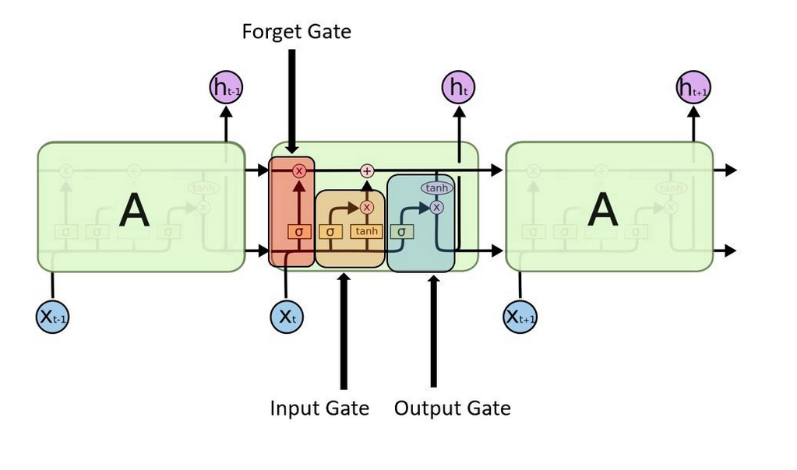

Slide 8
Steps followed:
Step1 : Web scrape the list of S&P stocks and fetch 2 years historical data
Step2 : Calculate the value of RSI & SMA
Step3 : Categorize the stocks into oversold or overbought and sort according to the values Select top 3(overbought) & bottom 3(Oversold)
Step4 : Create data frame by combining the values of RSI and SMA , close price and label future close
Step5 : Input data with a memory of 3 days into LSTM and fine tune parameters for each stocks to build the model.
Step6 : Forecast for next day.

Slide 9
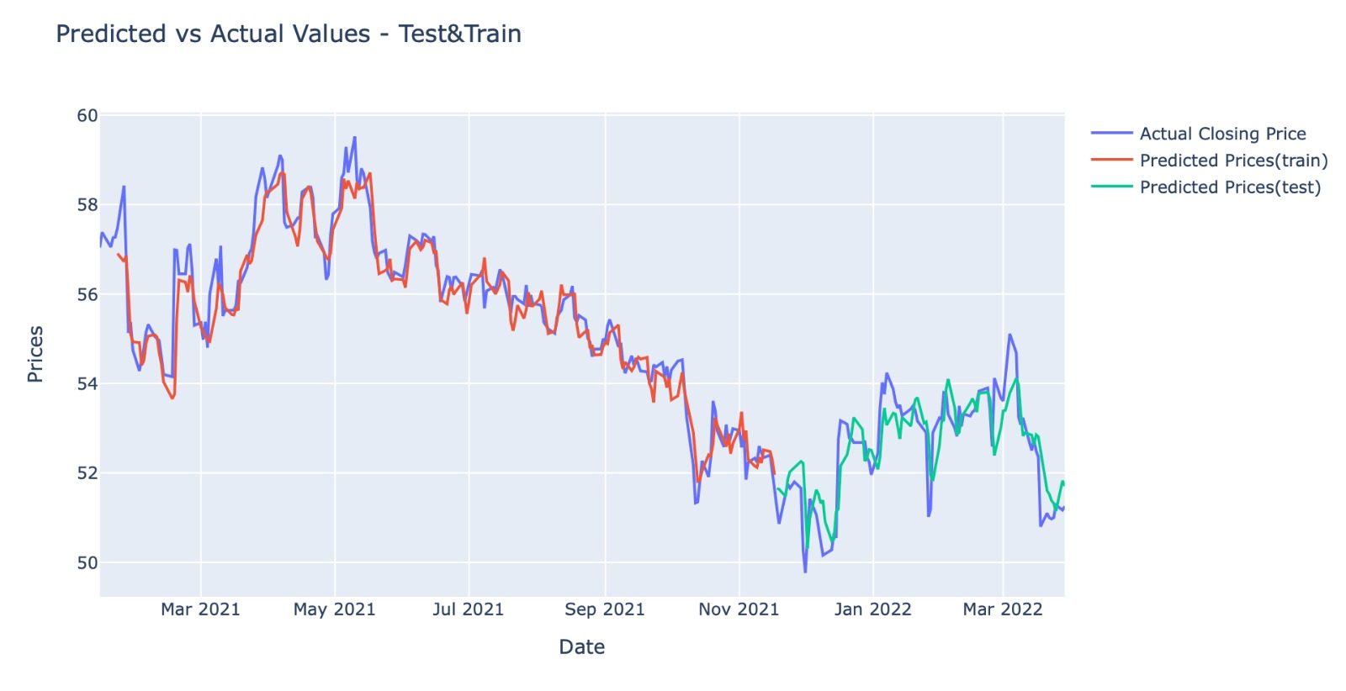

Slide 10
TODAYS RECOMMENDATION & Prediction (MaR 30)
Number of oversold stocks – 1
Number of undersold stocks – 29
Top oversold stocks – Invesco(IVZ) , Bristol-Myers Squibb (BMY)
Top undersold stocks – Verizon (VZ)
Prediction:
 | Actual | Predicted
IVZ | 23.42 | 22.87
BMY | 73.70 | 73.18
VZ | 51.58 | 51.22

Slide 11

CODE WALK THROUGH

